Slide 1
Updates for Cargill 6/09/20

Slide 2
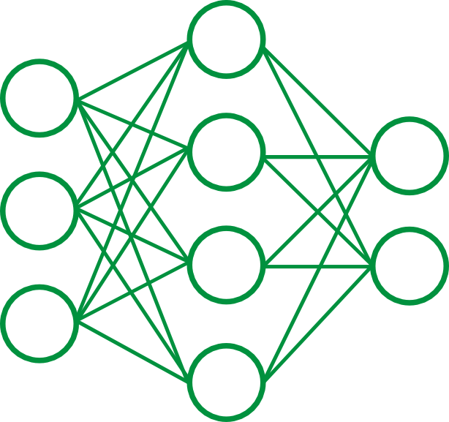
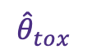
Feature Generation Pipeline
Input
Data
CCCCCOC(=O)CCC(=O)O
BrC1=C(NC(=O)C=C1)OCCOCCOC=N
C1=C(C2CO2)S(=O)(=O)C2=C(OCCO2)S1
BrC1=C2CC3(COCCO3)C(C=O)C2=CC=N1
C(=O)N1CCOC=O…
Chemical Properties
Structural Fingerprints
Toxicity
…
N1
CCCCCOC(=O)CCC(=O)O
BrC1=C(NC(=O)C=C1)OCCOCCOC=N
C1=C(C2CO2)S(=O)(=O)C2=C(OCCO2)S1
C(=O)N1CCOC=O…
1 | 0 | 0 | 1 | … | 0 | 1 | 0
0 | 0 | 0 | 0 | … | 0 | 0 | 1
0 | 1 | 0 | 0 | … | 0 | 1 | 0
1 | 1 | 0 | 0 | … | 0 | 0 | 0
=O
$${\hat{θ}}_{tox}$$
C
*nn trained on tox21 dataset

Slide 3
Feature Generation Pipeline
Input
Data
CCCCCOC(=O)CCC(=O)O
BrC1=C(NC(=O)C=C1)OCCOCCOC=N
C1=C(C2CO2)S(=O)(=O)C2=C(OCCO2)S1
BrC1=C2CC3(COCCO3)C(C=O)C2=CC=N1
C(=O)N1CCOC=O…
Chemical Properties
Structural Fingerprints
Toxicity
…
N1
CCCCCOC(=O)CCC(=O)O
BrC1=C(NC(=O)C=C1)OCCOCCOC=N
C1=C(C2CO2)S(=O)(=O)C2=C(OCCO2)S1
C(=O)N1CCOC=O…
1 | 0 | 0 | 1 | … | 0 | 1 | 0
0 | 0 | 0 | 0 | … | 0 | 0 | 1
0 | 1 | 0 | 0 | … | 0 | 1 | 0
1 | 1 | 0 | 0 | … | 0 | 0 | 0
=O
$${\hat{θ}}_{tox}$$
C
{
*nn trained on tox21 dataset
Pipeline can be used to generate features for any given set of molecules
GDB-17
Plasticizers
PubChem
Organics

Slide 4
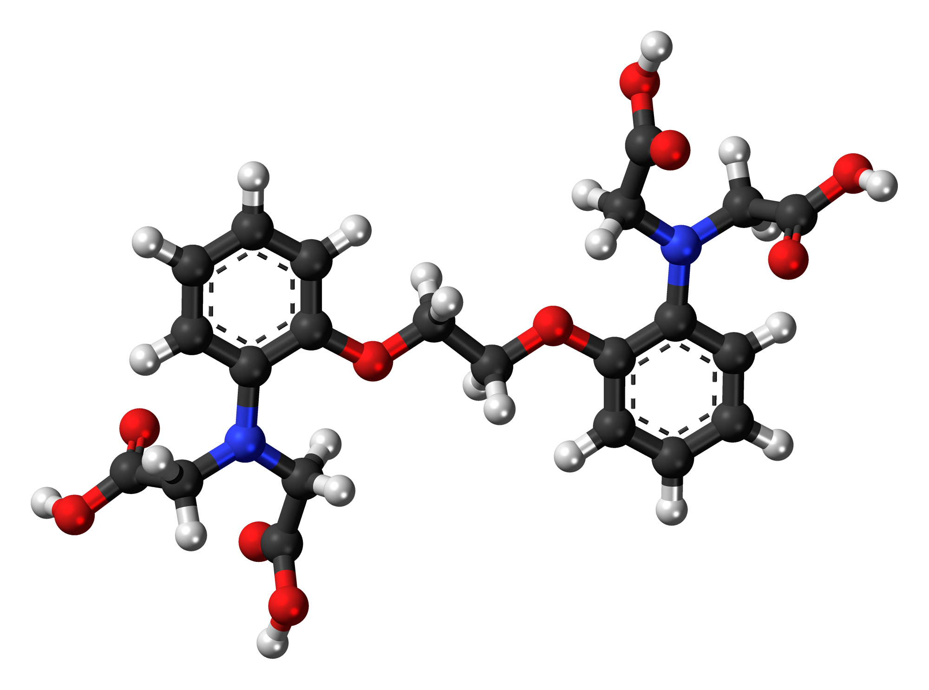
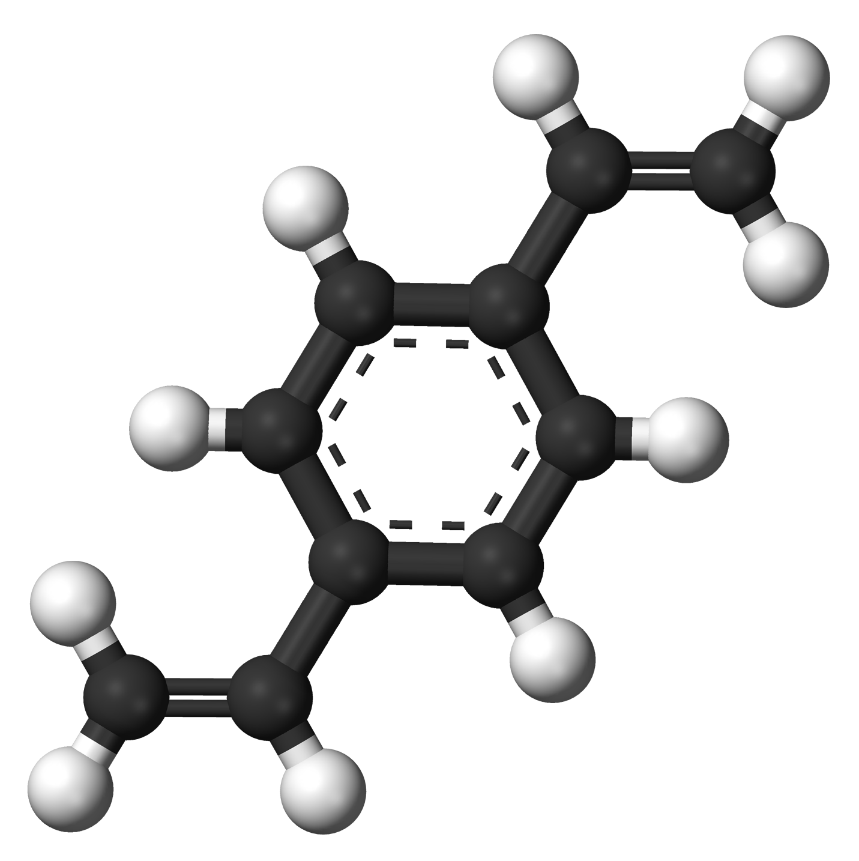

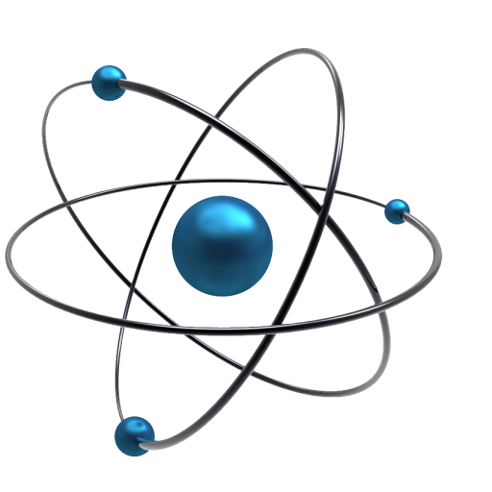
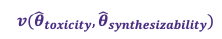
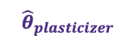
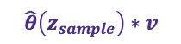
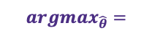
Proposed Learning Pipeline
Molecular Generation
$${argmax}_{\hat{θ}}=$$
Decoder
Reconstructed
SMILES
Encoder
SMILES
Feature Gen
Property
Predictor
$$v({\hat{θ}}_{toxicity},{\hat{θ}}_{synthesizability})$$
$${\hat{θ}}_{plasticizer}$$
$$\hat{θ}\left(z_{sample}\right)∗v$$

Slide 5
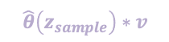
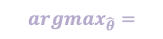

Proposed Learning Pipeline
Molecular Generation
$${argmax}_{\hat{θ}}=$$
Decoder
Reconstructed
SMILES
Encoder
SMILES
Property
Predictor
$$v({\hat{θ}}_{toxicity},{\hat{θ}}_{synthesizability})$$
$${\hat{θ}}_{plasticizer}$$
$$\hat{θ}\left(z_{sample}\right)∗v$$

Slide 6

Proposed Learning Pipeline
Molecular Generation
$${argmax}_{\hat{θ}}=$$
Decoder
Reconstructed
SMILES
Encoder
SMILES
Property
Predictor
$$v({\hat{θ}}_{toxicity},{\hat{θ}}_{synthesizability})$$
$${\hat{θ}}_{plasticizer}$$
$$\hat{θ}\left(z_{sample}\right)∗v$$

Slide 7
Proposed Learning Pipeline
Molecular Generation
$${argmax}_{\hat{θ}}=$$
Decoder
Reconstructed
SMILES
Encoder
SMILES
Property
Predictor
$$v({\hat{θ}}_{toxicity},{\hat{θ}}_{synthesizability})$$
$${\hat{θ}}_{plasticizer}$$
$$\hat{θ}\left(z_{sample}\right)∗v$$

Slide 8
Proposed Learning Pipeline
Molecular Generation
$${argmax}_{\hat{θ}}=$$
Decoder
Reconstructed
SMILES
Encoder
SMILES
Property
Predictor
$$v({\hat{θ}}_{toxicity},{\hat{θ}}_{synthesizability})$$
$${\hat{θ}}_{plasticizer}$$
$$\hat{θ}\left(z_{sample}\right)∗v$$

Slide 9
Proposed Learning Pipeline
Molecular Generation
Use Cases 1 and 2
Relate chemical properties/structure to plasticizing likelihood
$${argmax}_{\hat{θ}}=$$
Decoder
Reconstructed
SMILES
Encoder
SMILES
Property
Predictor
$$v({\hat{θ}}_{toxicity},{\hat{θ}}_{synthesizability})$$
$${\hat{θ}}_{plasticizer}$$
$$\hat{θ}\left(z_{sample}\right)∗v$$

